Slide 1
Implementation of a User-Interactive Digital Clock and Alarm System with LCD Display
By Amaresam Nikhita

Slide 2
Objective:
This project aims to develop a user-friendly digital clock and alarm system with an LCD display. Users can set the time and alarm using intuitive controls, and a buzzer will sound when the alarm time is reached.

Slide 3
Features:
Clock setting:
Pressing the left user key increments the hour value within a 0-23 range and pressing the right user key increments the minute value within a 0-59 range. The LCD’s first row displays the current time, updating instantly as adjustments are made according to the user
Alarm Setting:
Pressing the up user key increments the alarm hour and pressing the down user key increments the alarm minute. After setting alarm time click of center key activates the alarm settings. The LCD's bottom row shows the set alarm time.
Alarm Activation:
When the current time matches the set alarm time, an onboard buzzer sounds, providing an audible alert.

Slide 4
Implementation Details:
Hardware Components:
NXP LPC11C24 Micro Controller
Liquid Crystal Display(LCD)
User Keys
Piezo Buzzer
Software Components:
Embedded C
Keil IDE
Flash Magic

Slide 5
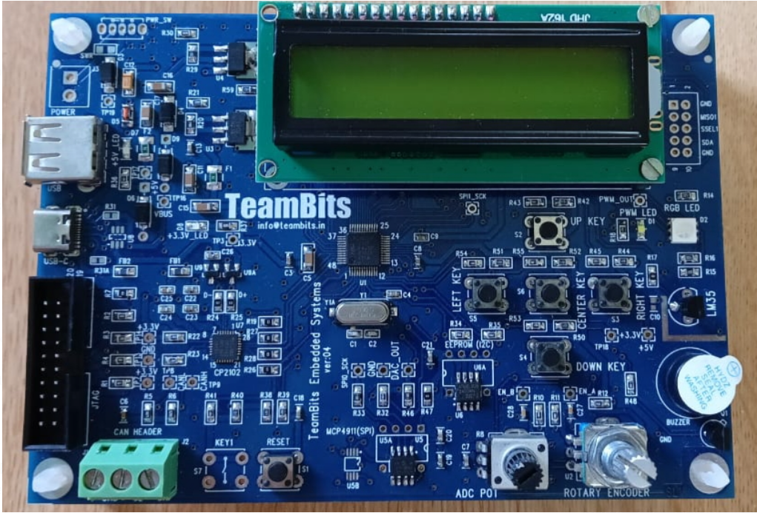
This is my Team Bits hardware kit and the features of this are:
Power supply:USB-powered with 5V and 3.3V outputs.
Clock generation:12MHz crystal oscillator enabling a 48MHz system clock.
User interface components:
16x2 alphanumeric LCD.
Five user keys.
RGB LED and buzzer.
Rotary encoder.
Analog and Digital Interfaces:
PWM-controlled LED.
0 to 3.3V voltage sensor (potentiometer).
LM35 temperature sensor.
Memory and Communication:
Serial EEPROM (24C08) via I2C.
Serial DAC (MCP4911) via SPI.
USB-UART bridge (CP2102).
Additional Features:
3-pin CAN port.
10-pin debug port compatible with SWD interface.

Slide 6
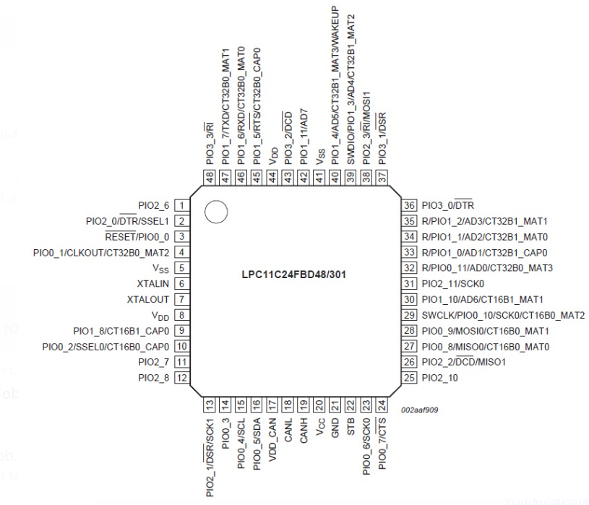
The NXP LPC11C24 microcontroller has the following features:
It is 48-pin integrated chip
It is operating on 3.3V operation with 5V tolerant I/Os.
It contains 32-bit ARM Cortex-M0 running up to 50 MHz
Memory:
32 KB Flash for firmware storage.
8 KB SRAM for volatile data.
16 KB ROM containing CAN drivers.
Timers:
24-bit Systick timer.
Watchdog Timer (WDT).
Four general-purpose timers: two 32-bit (GPT0, GPT1) and two 16-bit (GPT2, GPT3).
I/O Configuration: System Configuration (SYSCON) and Input/Output Configuration (IOCON) blocks.
Digital I/O Ports: Four ports (GPIO0 to GPIO3), each with up to 12 pins.
Analog-to-Digital Converter (ADC): 8-channel, 10-bit ADC (AD0 to AD7).
Communication Interfaces:
I2C.
SPI/SSP.
UART.
CAN with on-chip high-speed transceiver.

Slide 7
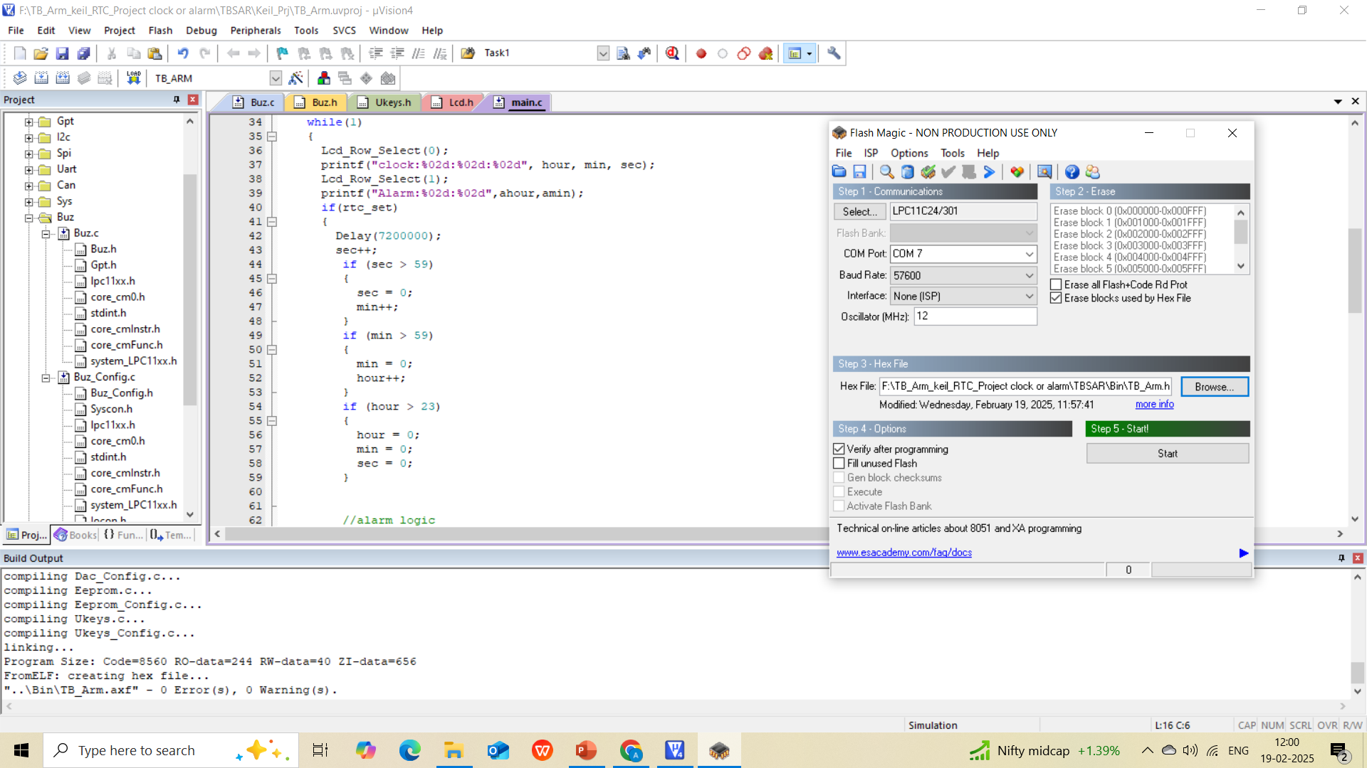
Output:
Fig: Flashing the program into hardware Board

Slide 8
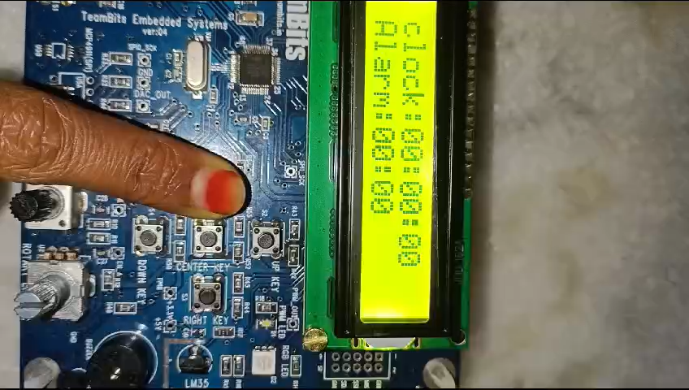
Result:
The clock time and alarm time are set using user keys. When the current time matches the alarm time, the buzzer beeps for one minute and then automatically shuts off.

Slide 9
Challenges and Solutions
Challenges Faced:
LCD display buffering issues.
Inaccurate delay function leading to rapid increments.
Alarm not activating under certain conditions.
Solutions Implemented:
Implemented double buffering to resolve LCD display issues.
Utilized hardware timers to achieve accurate delays.
Refined condition checks to ensure proper alarm activation.

Slide 10
Conclusion:
The digital clock and alarm system project has successfully met its main goals, providing a user-friendly interface with intuitive controls and real-time LCD feedback. The system effectively allows users to set the current time and alarm, with the buzzer feature providing timely alerts.

